Slide 1
UNIT 6. JAVA BEANS. COMPONENTS

Slide 2
https://en.wikipedia.org/wiki/JavaBeans
https://www.eg.bucknell.edu/~mead/Java-tutorial/javabeans/properties/bound.html
https://www.ctr.unican.es/asignaturas/MC_OO/Doc/JavaBeans_0910.pdf

Slide 3
SOFTWARE COMPONENTS
A component is a unit of software that has a set of interfaces and requisites. Components are developed, acquired, incorporated and assembled with other components in an independent way.
The purpose of components is to build applications assembling reusable modules.
In Java components are libraries of classes compiled together in a JAR FILE. They are called JavaBeans.

Slide 4
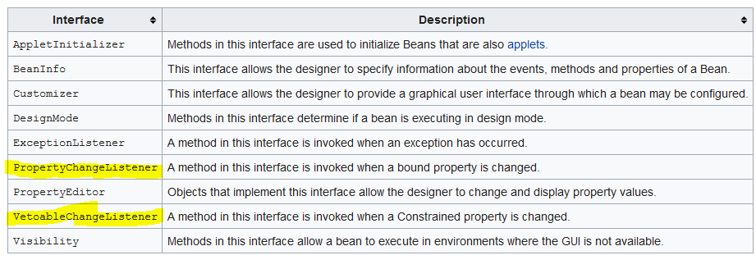
JavaBeans API

Slide 5
JavaBeans are classes that encapsulate many objects into a single object (the bean). They are serializable, have a zero-argument constructor, and allow access to properties using getter and setter methods. The purpose of JavaBeans to create reusable software components for Java.

Slide 6
JavaBeans Features
Introspection: a process of showing or giving information about the capabilities of the Bean to determine its capabilities. It’s done using naming patterns and through a class Bean Information
Properties: is a subset of a Bean's state. The values assigned to the properties determine the behaviour and appearance of that component. It is set through setter methods and can be obtained by getter method.
Customization: Progammers can change the appearance and behaviour of a component.
Events: is the way to communicate Beans with other Beans.
Persistence: Keep the state of a Bean and restore it later. Based on serialization.

Slide 7
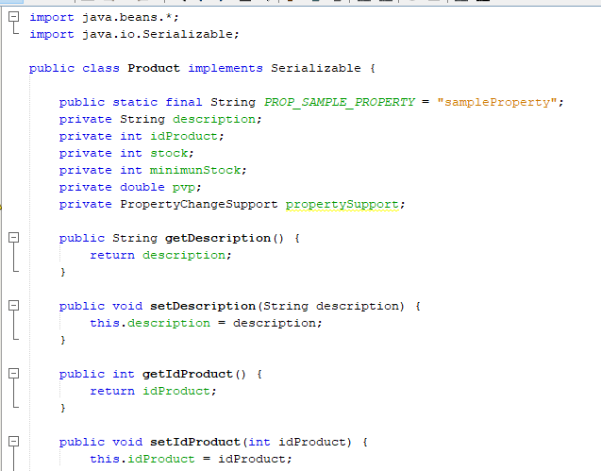
Javabean example: Product

Slide 8
Properties. Types
Simple property: they represent an only value.
Indexed property: represent an array of values
Bound property: they are bound to events. When an event occurs, they react in some way. Whenever a bound property changes, notification of the change is sent to interested listeners.
Restricted properties: similar to bound properties, but the listeners can veto that properties

Slide 9
Bound properties
https://www.eg.bucknell.edu/~mead/Java-tutorial/javabeans/properties/bound.html
The class PropertyChangeSupport implements methods that add and remove PropertyChangeListener objects from a list, and fires PropertyChangeEvent objects at those listeners when the bound property changes. Your Beans can inherit from this class, or use it as an inner class.
By implementing the PropertyChangeListener interface the listener can be added to the list maintained by the bound property Bean, and because it implements the PropertyChangeListener.propertyChange method, the listener can respond to property change notifications.
The PropertyChangeEvent class encapsulates property change information, and is sent from the property change event source to each object in the property change listener list via the propertyChange method.

Slide 10
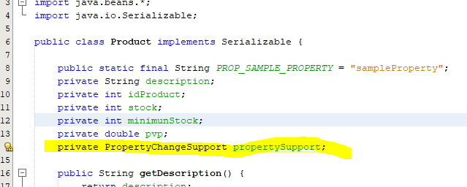
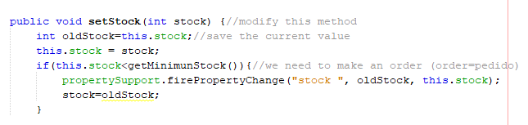
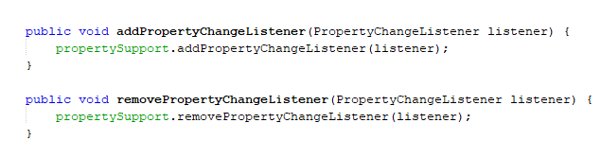

Slide 11
PRACTICE 6.1. CREATING JAVABEANS IN NETBEANS

Slide 12
PRACTICE 6.2. USING JAVABEANS TO ACCESS DATABASES

